Slide 1
论文发表的规范与技巧
徐白露
BioMed Central 中国区培训主管
Notes:
中文

Slide 2

About BioMed Central
First open access publisher 最早的开放获取出版社
- 15 years old this year; >290 journals; 30,000 articles + per year
- Now part of Springer Nature
Every research article is: 每篇文章都符合以下要求
- Peer reviewed 通过同行评审
- Freely and immediately accessible to everyone; CC-BY,
立即对所有人免费开放
- Archived in PubMed Central and other archives
永久存储于PubMed Central及其他数据库
Many journals are:
- Indexed in MEDLINE, Biosis (all biology titles)
- Tracked by Thomson-Reuters for Impact Factors
大部分期刊被SCI收录，有影响因子
Notes:
Change this, 15 years as OA publisher. Update figures. CC-BY. Make that point.

Slide 3
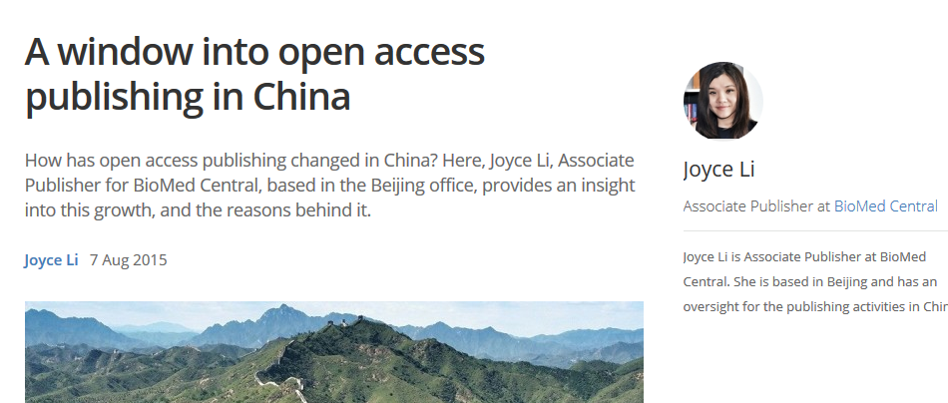
http://blogs.biomedcentral.com/bmcblog/2015/08/07/window-open-access-publishing-china/
Open Access in China
“A big step for open access in China came in May 2014 at the Global Research Council meeting held in Beijing. CAS and National Natural Science Foundation of China (NSFC) announced the first open access mandate at national level requiring researchers to make their work free access within 12 months of publication.”
中国开放获取的飞越来自2014年全球研究理事会在北京召开的年会，中科院和基金委联合发布了中国第一个强制开放获取的国家级政策，要求研究人员在论文发表后12个月内将其公开存储，供公众免费访问。
Notes:
Why OA is important in China.

Slide 4

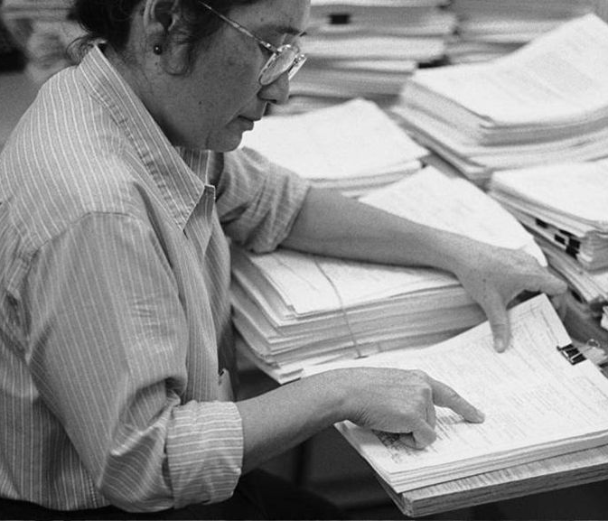
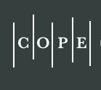
论文发表的规范与技巧
          Manuscript preparation
          Choose the right journal
          Peer review
          Publication ethics

Slide 5
          Manuscript preparation
          Research ethics and consent
          Good reporting and adherence to policy
          Abstract
          Cover letter

Slide 6

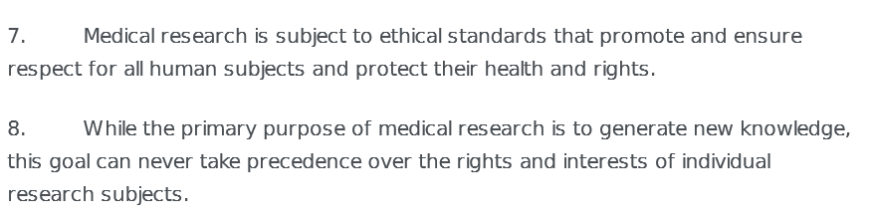
          For Clinical Research
Declaration of Geneva (1948)
“THE HEALTH OF MY PATIENT will be my first consideration;”
我会把病人的健康视作首要考虑

Slide 7
          For Clinical Research
The following are absolute requirements in BMC Series:
    Approval from an ethics committee (涉及人体、人体材料或与人有关数据的研究，伦理委员会名称和伦理审核注册号)
    Consent to participate in the research (前瞻性研究、面谈、小组讨论、事先采集样本、16岁以下的参与者；若伦理委员会不需要知情同意书，须提供相关证明文件)
    Consent to publish identifiable details (包含可识别患者身份的信息；伦理审核委员会无权豁免)
    Trial Registration Number (所有临床试验皆需要招募受试者前注册)

Slide 8
          For Clinical Research
Case 1
Ethical Concerns
Researchers recruit patients to a trial to test a new drug for asthma
研究人员招募患者参与一项关于治疗哮喘的新药研究
Patients are divided into two groups:
  Group 1: receive standard treatment plus the new drug
  Group 2: receive standard treatment plus placebo
患者分两组：1、接受标准疗法+新药；2、接受标准疗法+安慰剂
?……

Slide 9
          For Clinical Research
Case 1
Ethical Concerns
Should have ethics approval
应该通过伦理审核
Patients should be told they are part of a trial and give informed consent
病人应被告知他们处于一项临床试验，并签署知情同意
Patients should know what the trial involves and what treatments available.
病人应知道试验的内容，以及可行的疗法
If patients too young, parental consent should be obtained.
如果病人未成年，须由家长签署知情同意

Slide 10
          For Clinical Research
Case 2
Ethical Concerns
Researchers want to test a new, untested drug for treating Helicobacter pylori
科研人员试验一项未被试验过的新药，该药有可能被用于治疗幽门螺杆菌
The researchers submit this protocol to their ethics committee
Patients are divided into three groups:
  Group 1 are treated with standard therapy plus new drug
  Group 2 are treated with standard therapy plus placebo
  Group 3 are treated with the new drug only
患者分三组：1、标准疗法+新药；2、标准疗法+安慰剂；3、只给新药
?……
Notes:
Will the ethics committee approve it?

Slide 11
          For Clinical Research
Case 2
Ethical Concerns
Withholding standard treatment for group 3 is a concern
  This group potentially had no effective treatment
  They were put at risk
  This protocol is not ethical
  未对第三组患者采用标准疗法，存在问题
  第三组患者未被有效治疗，健康受到威胁，该实验设计不符合伦理准则
An institutional ethics committee would not approve it.
机构的伦理审核委员会不能批准该实验设计

Slide 12
          For Animal Study
  All research on vertebrates or any regulated invertebrates must have an ethics statement.
  所有对脊椎动物或被监管的非脊椎动物进行的实验必须通过伦理审核
    Research must have been performed in accordance with the 3Rs of animal research: 研究须遵守动物实验的3R标准
    Replacement (replace use of animals where possible) 替代
    Reduction (minimise number of animals used per experiment) 减少数量
    Refinement (minimise suffering and improve animal welfare). 减少痛苦

Slide 13
          For Animal Study
Case 3
Ethical Concerns
Researchers submit a manuscript describing a study investigating the effect of gastric emptying and acid secretion on stress ulceration of the gastric mucosa.
该论文研究的是胃排空和胃酸分泌对应激性胃溃疡的影响
144 rats are divided into three groups (48 per group).
144只大鼠被分为3组（每组48只）
All undergo a water immersion restraint test and two groups also undergo surgery before this test (with or without removal of gastric contents).
所有动物经过浸水束缚实验，其中两组在此前要进行手术（是否摘除胃内容物）
The manuscript says the study had ethics approval.
文中说该研究通过伦理审核
?……

Slide 14
          For Animal Study
Case 3
Ethical Concerns
Large number of rats were used.
使用大鼠的数量过大
Concerns raised about animal welfare, given a restraint test was used after surgery.
在术后进行束缚实验，涉及动物权益问题

Slide 15
          Manuscript preparation
          Research ethics and consent
          Good reporting and adherence to policy
          Abstract
          Cover letter

Slide 16
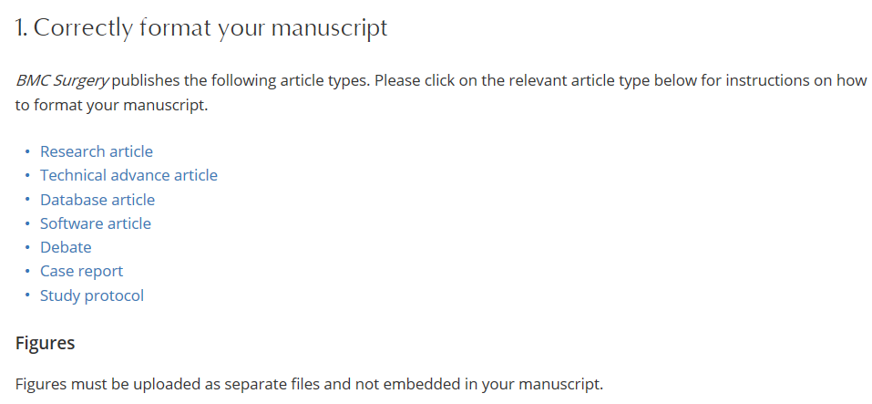
          Instructions for Authors

Slide 17

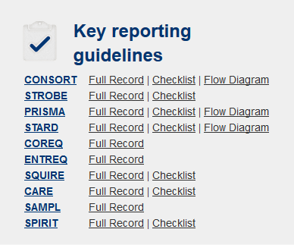
          Standards of reporting
提高医学研究的质量和透明度
Help editors, reviewers and readers understand what you did
帮助编辑、审稿人和读者更好地理解你的文章
http://www.equator-network.org/

Slide 18
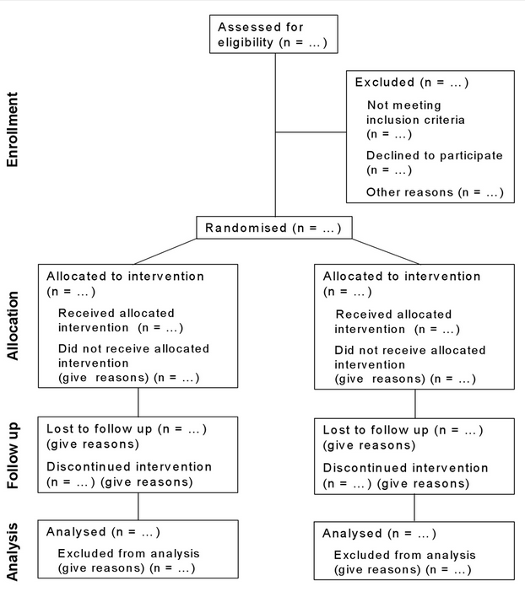
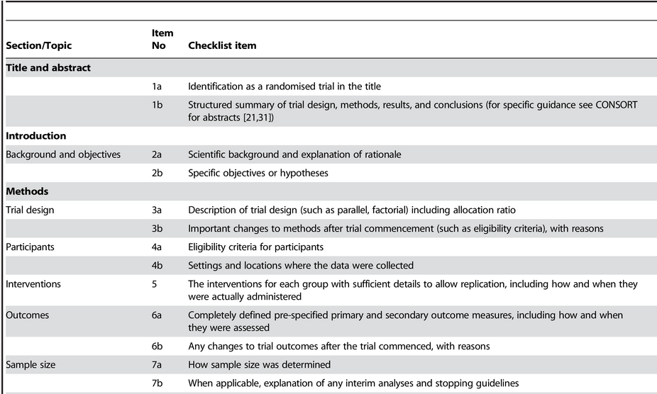
          Example: CONSORT

Slide 19
          Manuscript preparation
          Research ethics and consent
          Good reporting and adherence to policy
          Abstract
          Cover letter

Slide 20
          Abstract
The abstract is the only detail invited reviewers see before they agree to peer review
审稿人在同意为文章审稿之前，只能看到文章摘要。
A badly written and unclear abstract might mean
  The editor misses the importance of the work
  Peer reviewers decline to review
  差的摘要可能会是编辑和审稿人拒绝审稿
Visibility:
  Use keywords that will attract readers
  选择适当的关键词，抓住读者的搜索习惯，以增加文章可见度

Slide 21
http://www.biomedcentral.com/1741-7015/13/207
          Case. For a research article
Background: Whether coffee consumption affects the risk of developing atrial fibrillation (AF) remains unclear. We sought to investigate the association between coffee consumption and incidence of AF in two prospective cohorts, and to summarize available evidence using a meta-analysis.
Methods: Our study population comprised 41,881 men in the Cohort of Swedish Men and 34,594 women in the Swedish Mammography Cohort who had provided information on coffee consumption in 1997 and were followed up for 12 years. Incident cases of AF were ascertained by linkage with the Swedish Hospital Discharge Register. For the meta-analysis, prospective studies were identified by searching PubMed and Embase through 22 July 2015, and by reviewing the reference lists of retrieved articles. Study-specific relative risks were combined using a random effects model.
Results: We ascertained 4,311 and 2,730 incident AF cases in men and women, respectively, in the two cohorts. Coffee consumption was not associated with AF incidence in these cohort studies. The lack of association was confirmed in a meta-analysis, including six cohort studies with a total of 10,406 cases of AF diagnosed among 248,910 individuals. The overall relative risk (95 % confidence interval) of AF was 0.96 (0.84–1.08) for the highest versus lowest category of coffee consumption, and 0.99 (0.94–1.03) per 2 cups/day increment of coffee consumption.
Conclusions: We found no evidence that coffee consumption is associated with increased risk of AF.
Formatted, detailed, key results, clear conclusions.
排版正确、详细、主要结果、结论清晰

Slide 22
          Manuscript preparation
          Research ethics and consent
          Good reporting and adherence to policy
          Abstract
          Cover letter

Slide 23
          Cover Letter
Explain the scientific question you are addressing clearly
提出什么科学问题？
Explain the significance of your results clearly
对该领域、期刊读者群、更广领域的重要性
    -for the field
    -the journal’s target audience
    -the broader community
Provide any details the editor should know (e.g. Competing Interests)
提供编辑应该知道的一切信息（如：竞争关系）
State that the manuscript is not under consideration at another journal
说明该文章并没有同时投给其他期刊
Notes:
How to convince an Editor….

Slide 24
          Good Example
Dear Dr Furlong,
I would like to submit this study describing a novel family of microRNAs to Genome Medicine.
This family acts through a previously unrecognized mechanism and here we show for the first time that these microRNAs regulate a key breast cancer pathway.
Recent studies on this topic have been published in Nature, suggesting that this is an area of broad interest (see references 1-3 below).
These findings should be of interest to anyone working on noncoding RNAs or on breast cancer signalling pathways.
We can confirm that the manuscript is not under consideration by any other journal at this present time. The raw data supporting our findings have been uploaded to….
Potential reviewers for the study include…..
We look forward to hearing from Genome Medicine in due course,
Detailed, clear, explains why people will be interested in findings, supporting data available, potential reviewers suggested.
详细清楚地解释了为何有人会对这些发现感兴趣，数据支持，建议了潜在审稿人

Slide 25
论文发表的规范与技巧
          Manuscript preparation
          Choose the right journal
          Peer review
          Publication ethics

Slide 26
          List of Candidate Journals
Topic of the Manuscript (Journal Categories)
What audience do you want to reach?
Who could be the editors and reviewers for these journals?
What studies have these journals published recently?
查看期刊的读者群、编辑和审稿人、近期发表的文章
Evaluate your findings (Impact factor)
How big is your advance?
How interesting are your findings?
客观评价研究成果的创新性
Notes:
Summarise and go over points illustrated

Slide 27
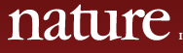
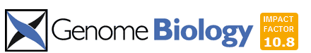
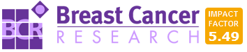
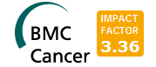
Where to submit a paper on the role of a family of microRNAs in breast cancer?
该文章关于和乳腺癌有关的microRNA家族
          Example
A new family of microRNAs acts through a novel mechanism to alter a key pathway in breast cancer that strongly supports a novel way of treating the disease
新micro-RNAs家族通过全新机制来改变乳腺癌的关键通路，从而强有力地支撑治疗该疾病的新方法
Ground-breaking findings 里程碑式的新发现
A known family of microRNAs acts through a novel mechanism to alter a key pathway in breast cancer
已知的microRNAs家族通过全新机制来改变乳腺癌的关键通路
Genomics researchers 基因组相关的研究人员
a known family of microRNAs is shown to alter a pathway that has been implicated in breast cancer
已知的microRNAs家族通过已有机制来改变乳腺癌的关键通路
Cancer researchers 癌症相关的研究人员
a known family of microRNAs is confirmed to regulate a breast cancer pathway
证实已知的microRNAs家族可改变乳腺癌的关键通路
- Breast cancer researchers 乳腺癌相关的研究人员

Slide 28
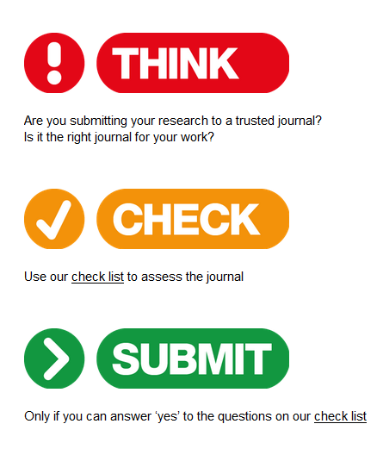
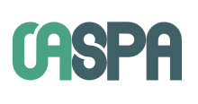

http://thinkchecksubmit.org/
          Choose Target Journals
思考：准备投稿的期刊是否值得信赖？是否适合你的研究？
检查：使用检查表来核查该期刊是否值得信赖
投稿：只有在得到肯定答案后方可投稿
http://publicationethics.org/
http://oaspa.org/
https://doaj.org/
Notes:
Importance of trusting the journal

Slide 29
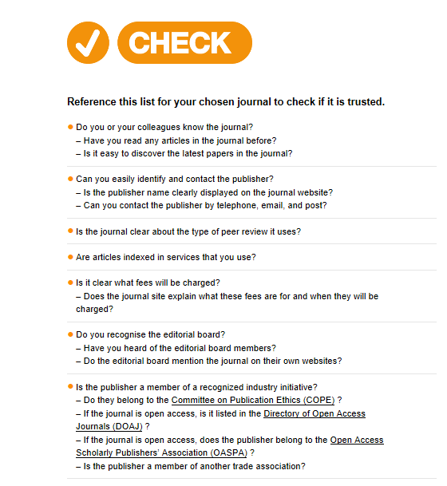
Use the checklist
when you are
choosing a journal
选择期刊时使用核对表
进行检查

Slide 30








          Factors for Consideration
- impact factor 影响因子
- reputation 名声
- speed 审稿速度
- visibility 论文可见度
- open access 开放获取
-model of peer review 审稿模式
…

Slide 31
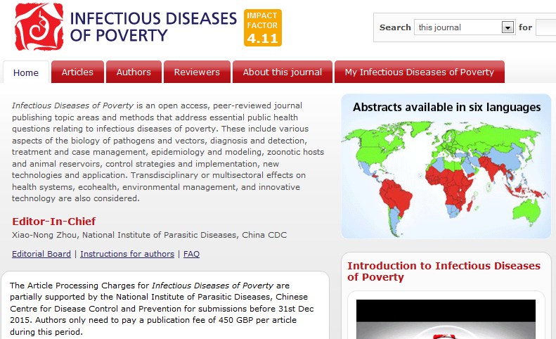
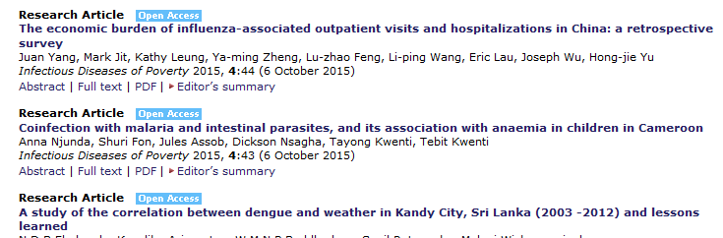
          Check points
Scope,
Articles,
Reputation,
Editor,
Open Access,
Visibility?
Notes:
Interact with this slide and point out things authors should consider. Need to use arrows to point to relevant things.

Slide 32
          Case study - 1
You have decided on a journal to submit to, but are worried you won’t be able to write the manuscript in adequate English. 投稿前觉得自己的英语不够好
You see an advertisement from an agency that offers help with writing manuscripts. They can guarantee acceptance for a fee. 看到广告可帮助写文章，支付费用保证发表
          Do you trust them?可以信赖他们吗？
They re-write the manuscript for you in English and offer to manage the submission process for you.该机构帮助改写了文章，同时表示可以帮助投稿
          Should you agree to this?应该同意吗？
They tell you they can find peer reviewers for you to suggest.还能向编辑推荐审稿人
          Should you allow them to do this?应该让他们这么做吗？

Slide 33
          How to avoid the pitfalls
Never hand over total control of your manuscript to anybody who is not an author. 永远不要把自己的文章交给不是本文作者的人
If you want to use an agency to improve the manuscript, tell the editor that they are acting on your behalf when you submit your manuscript. 如果需要使用第三方来改进自己的文章，一定要告诉编辑有人替你做这些。
Remember that you, the authors, will still be responsible for anything the agency does.切记，作为本文作者，随时要为第三方机构的一切操作负责

Slide 34
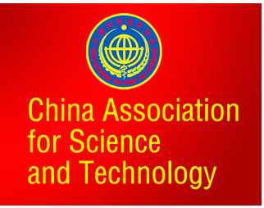
          How to avoid the pitfalls
中国科协等七部门联合印发“五不准”规范学术论文发表
不由“第三方”代写论文。
科技工作者应基于自身研究工作和真实的实验数据完成论文撰写，
坚决抵制“第三方”提供论文代写服务。
不由“第三方”代投论文。
科技工作者应学习、掌握国际学术期刊投稿程序，亲自完成提交论文、回应评审意见的全过程，坚决抵制“第三方”提供论文代投服务。
不由“第三方”对论文内容进行修改。
论文作者委托“第三方”进行论文语言润色，应基于作者完成的论文原稿，且仅限于对语言表达方式的完善，坚决抵制以语言润色的名义修改论文的实质内容。
不提供虚假同行评审人信息。
科技工作者在国际学术期刊发表论文如需推荐同行评审人，应确保所提供的评审人姓名、联系方式等信息真实可靠，坚决抵制同行评审环节的任何弄虚作假行为。
不违反论文署名规范。
所有论文署名作者应事先审阅并同意署名发表论文，并对论文内容负有知情同意的责任；论文起草人必须事先征求署名作者对论文全文的意见并征得其署名同意。论文署名的每一位作者都必须对论文有实质性学术贡献，坚决抵制无实质性学术贡献者在论文上署名。
http://www.cast.org.cn/n35081/n35096/n10225918/16658364.html

Slide 35
论文发表的规范与技巧
          Manuscript preparation
          Choose the right journal
          Peer review
          Publication ethics

Slide 36
          The Peer-review System
“Peer review is the evaluation of scientific research findings for validity, significance and originality, by qualified experts who research and submit work for publication in the same field (peers).”
同行评审是通过具有相似研究背景、具备资格的专家，来评价研究成果的合理性、重要性和原创性的过程。
Paper submitted to Journal
Editor sends paper to reviewers
Independent experts advise on manuscripts submitted for publication
各自独立的业内专家为每篇投稿提出评审意见
Constructive feedback from reviewers is highly valued by authors
来自评审和编辑的建设性反馈意见一贯受到作者的高度重视
Reviewers return comments
Editor makes decision
Reject
Accept
Send back for revision
www.senseaboutscience.org/data/files/resources/17/peerReview.pdf‎

Slide 37

          Assessment by Editor
Does your manuscript match the scope?
该研究是否符合期刊主题？
Is it a significant advance for this journal?
创新的程度是否符合期刊要求？
Are there any ethical concerns?
是否存在伦理问题？
Have you met requirements for data deposition?
是否符合数据存储规定？
Do you adhere to standards of reporting? (for study design and journal)
是否遵循报告标准？（实验设计规范和期刊要求）
Quality of Written English
语言质量
Notes:
Make point that Editors are busy people doing many things, the need to see quickly if all the above is ok.

Slide 38
          Assessment by Reviewers
Quality of submission 稿件质量
  Contribution to the literature: novelty, importance 对领域的贡献：创新等
  Appropriate methods and statistics 恰当的研究和统计方法
  Soundness of the analysis and conclusions 合理的分析和结论
  Clarity of aim of paper and achievement of aim 明确文章的目的和成就
  Presentation of figures, tables 图表的表达
  Existing literature cited appropriately 恰当地引用现有文献
Areas for improvement 哪些方面可以改进？
Notes:
Similar to Editor, but more detail on methodology

Slide 39
          Response to Reviewers’ Comments
Ensure you understand what reviewers and editors are asking for (if unsure ask the Editor)
明白评审和编辑提出什么要求
Provide a full, and concise point-by-point response to the reviewers and editors.
提交完整的回复，将评审和编辑的要求逐点做出说明
If you disagree with an issue, provide a clear rationale for your argument within the response. Back up with references where possible.
如果对评审提出的问题有异议，需在回复中提供详细的论证，最好附有参考文献
Give clear indication where revisions in the manuscript have been made (tracked changes, highlighted etc).
指明对文章的哪些部分进行了修改（表明更改部分，使用Word追踪修订功能）

Slide 40
          Appealing against an Editor’s decision
  Be clear that you are appealing against the decision (rather than just voicing your disappointment)
  不要只是陈述自己有多失望，明确是对结果进行申诉
  Be clear what specific scientific issue is at the root of the appeal
  指明支撑该申诉的根本是哪些点
  E.g. Reviewers or Editor made factual errors or missed important considerations
  知名审稿人犯了哪些实质性错误
  Specific evidence of reviewer bias
  关于审稿人偏见的明确证据
  Construct a comprehensive rebuttal - focus on the science
  一个全面的反驳须建立在科学的基础上

Slide 41
          A real example of an appeal
A manuscript on DNA methylation patterns is rejected after peer review.
一篇关于DNA甲基化的文章在同行评审后被拒稿
Reason for rejection: one of the reviewers says the paper is not novel.
拒稿原因：其中一个审稿人说该文章创新性不够
The reviewer cites three previous publications, which he says have published similar findings.
审稿人引用了3篇已发表的文章来说明别人已经发表过相似的研究
The author disagrees with this reviewer. What should the author do?
作者不同意审稿人的观点，该怎么做？
?……

Slide 42
          A real example of an appeal
The author should concentrate on the facts
作者应该关注事实
The author should explain that the reviewer has misinterpreted the findings of the previous papers if that is the case
该作者进行申诉，说明审稿人对已发表文章中的结果理解有误，与该文章并无直接联系
The author should explain the actual findings of each of the previous publications and what is new about their study.
作者详细解释了那3篇文章的实际研究结果
In this case he editor reads the articles and finds that the author is correct.
编辑仔细阅读那3篇文章，认为作者是正确的
The paper was ultimately published after revisions and re-review.
在修改和重新审稿之后该文章最终被接收

Slide 43
论文发表的规范与技巧
          Manuscript preparation
          Choose the right journal
          Peer review
          Publication ethics

Slide 44
          Publication Ethics
“A set of common rules among authors, editors, reviewers and publishers to protect integrity of the scientific record”.
Charlotte Haug, previous Vice Chair COPE.
出版伦理是作者、编辑、审稿人和出版社共同遵循以保护科学记录诚信的通用规则。
All parties responsible. Authors, reviewers, editors but responsibility rests on authors.
所有人都应负责，作者责任尤其大。
Readers can trust the articles they read and make informed decisions
读者可信任所读的文章，并作出判断。
Notes:
What do we mean by e.g. of publication ethics.

Slide 45

          Publication Ethics
“科研不端行为是一个全球性的问题。但是，当中国科研人员的学术不端成为全球新闻头条的时候，中国科学界整体声誉受损的程度要比其他国家发生类似事情时更严重。这显然不公平，但也说明中国更需要解决科研不端的问题。”
“医生需要发表文章才能晋升职称，而中国临床医生的工作量可能会多到让西方医生都惊讶的程度。”
“有91%的人认为中国的科研机构应该在发现，防范和惩罚不端行为方面加大力度。”
——转型中的中国科研
《自然出版集团白皮书》
Notes:
What do we mean by e.g. of publication ethics.

Slide 46
          Publication Ethics Issues
Plagiarism 抄袭
Duplicate submission/publication 一稿多投、重复发表
Undeclared competing interests 未注明竞争关系
Image manipulation 篡改图片
Authorship issues 著作权问题（添加无关作者/遗漏对文章有贡献的作者）
        Review of 2,047 retractions indexed in PubMed (Fang et al. 2012)
67.4% of retractions due to misconduct
PubMed 2047篇被撤回文章中，67.4%由于学术不端
Fraud 43.3% 造假
          Duplicate publication 14.2% 重复发表
          Plagiarism 9.8% 抄袭
Fang F, Steen R, Casadevall A. PNAS. 2012 109:42
http://www.pnas.org/content/109/42/17028.abstract

Slide 47
          Plagiarism
Definition: Duplication of text (or figures) from someone else’s work
How much overlap with someone else’s work is acceptable?
从别人的文章中复制多少文字和图片是被允许的？
  30%
  None
  10%
?……

Slide 48
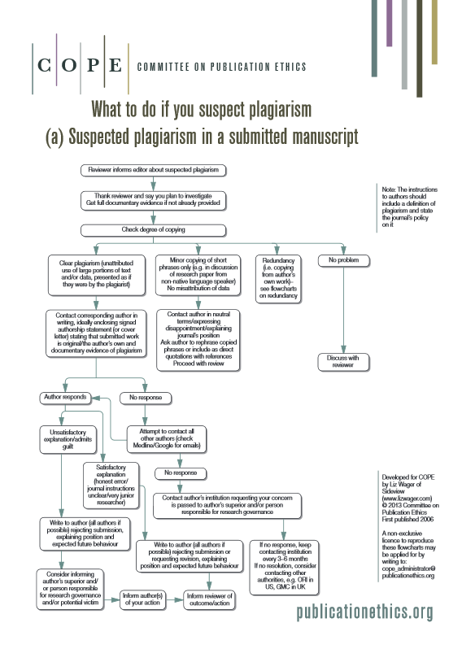
          How do Editors deal with plagiarism?
Follow COPE guidelines 遵循COPE的规定
Use plagiarism detection software 使用抄袭检查软件
During submission 投稿过程中发现抄袭
  Ask authors for explanation 要求作者解释
  Authors may be allowed to re-write 重写
  Manuscript may be rejected 拒稿
  Editor may contact authors’ institution 报告学校
After publication 发表后发现抄袭
  May publish retraction or correction 撤稿或修正

Slide 49
          Avoid Text Recycling (Self-Plagiarism)
Researchers have published a previous article reporting the primary outcomes of a large RCT.
研究者发表一篇文章，描述一大规模RCT的首要结果
They now want to publish another article reporting the secondary outcomes. The methods used are the same.
现在要发表另一篇文章，报告次要结果，实验方法与之前相同
How can they report the methods in their new paper?
在新文章中如何描述实验方法？
Original published article methods:
http://www.biomedcentral.com/1471-2458/14/748
“This study is an interactive web-based randomized trial (using pre and post-intervention assessments). Participants in this parallel study randomly will be assigned to one of two conditions: the intervention group and the waiting list group (the control group). Participants will be assessed at three points in time: at baseline, three and six months follow-up. Study procedure from enrolment through follow up data collection and analysis are depicted in Figure 1.”
?……

Slide 50
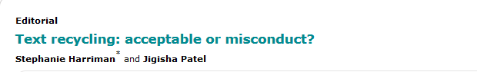
Transparently! http://www.trialsjournal.com/content/16/1/418
          Avoid Text Recycling (Self-Plagiarism)
“A detailed description of the method can be found elsewhere in a presentation of the study protocol [19]. Briefly, this study was designed to assess the effects of interactive web-based lifestyle intervention on metabolic syndrome. The main outcomes were a decrease in the components of metabolic syndrome…..”
no need to repeat the description of the methods as the authors provide a citation for the details.
authors are transparent that results reported in the new article are secondary outcomes from the previous study and don’t mislead the reader into believing this was another study.
不需要重复全部的方法，只需简要描述和引用原文为参考文献。这样做是为了将本次研究作为上次实验的后续，而不会让读者误以为这是个全新的试验。
http://www.biomedcentral.com/1741-7015/12/148/abstract
Notes:
Point out where further info can be found.

Slide 51
          Duplicate submission
A researcher is in a hurry to get their paper published as it is needed for their next grant submission.
某研究者急于发表论文，用于下次基金申请
They submit to three journals at the same time because they don’t know which will be the quickest.
于是同时向三个期刊投稿，因为不知道哪个更快

Slide 52
          Duplicate submission
Consequences of duplicate submission: 一稿多投的后果
  Wastes editors’ and reviewers’ time
  浪费编辑和审稿人的时间
  Rejection of both manuscripts
  被两边拒稿
  Editor may contact the authors’ institution
  编辑会通知作者单位
  Duplicate publication
  重复发表
  May lead to retraction
  造成撤稿

Slide 53
          Competing interests
Competing interests (CI) can be: 竞争关系体现在涉及钱和不涉及钱两方面
  Financial
  Non-financial
Importance of declaring CI on submission 投稿时注明竞争关系的重要性
  Editor is aware during manuscript assessments 在处理稿件时提醒编辑
  Editor will not invite reviewers with the same CI 不邀请有竞争关系的审稿人
  Reviewers are aware when assessing manuscript 提醒审稿人
  Readers are aware once published 在文章发表时提醒读者
Declaring a CI does not mean that an article will not be published
注明竞争关系并不意味着文章无法发表

Slide 54
          Competing interests – example 1
A researcher writes a paper reporting that a particular commercial sequencing technology works very well.
The researcher has shares in the company that makes the technology.
文章中指出一种商用的测序技术效果很好，同时该作者持有销售该测序技术公司的股票
  Is this a competing interest?
?……

Slide 55
          Competing interests – example 1
A researcher writes a paper reporting that there are no adverse effects of smoking on fertility.
Her husband works in the cigarette industry.
文章中指出吸烟对生育没有负面影响，同时该作者的丈夫在烟草行业工作。
  Is this a competing interest?
?……

Slide 56
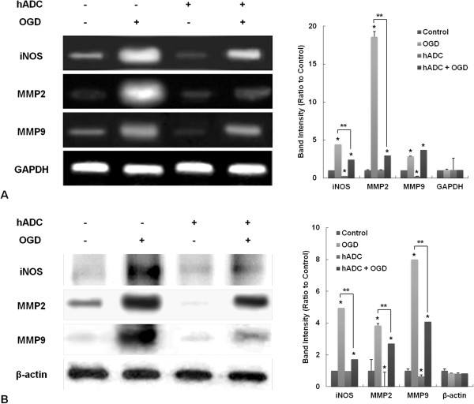
          Image manipulation – example
Editor sends a manuscript containing these images to reviewers.
编辑发给审稿人的文章中包含右侧图片
A reviewer notes that these images have been published previously.
审稿人指出这些图片曾出版过
Editor compares the image with the published article and agrees. The editor asks the authors to explain.
编辑与原出版物比较，同意，要求作者解释
The authors respond to say this is true – they run many gels and have only used these images to be representative of their results.
作者承认，解释说他们做过很多凝胶实验，只是用这些图片来代表实验结果

Slide 57
          Image manipulation – Ethical Concerns
Original data should always have accompanying explanation.
引用原有数据需要做出解释
If original data are being used just to illustrate a point, this needs a very clear statement in the manuscript explaining what is being demonstrated.
如果使用原有数据阐述某观点，须在论文中明确解释这组数据是用来证明什么
Original source must be cited and can only be re-used if the copyright holder gives permission).
须引用数据出处，并只有在征得许可后才可使用
If you misrepresent your data, you are deceiving your colleagues, who expect and assume basic scientific honesty—that is, that each image you present is an accurate representation of what you actually observed.
Manipulating images to make figures more simple and more convincing may also deprive you and your colleagues of seeing other information that is often hidden in a picture or other primary data.
Rossner and Yamada; Journal of Cell Biology 2004;166:11–15
http://jcb.rupress.org/content/166/1/11.full

Slide 58
International Committee of Medical Journal Editors (ICMJE) guidelines on authorship:
国际医学期刊编辑协会ICMJE指南，这样解释著作权
          Authorship issues
To qualify as an author a researcher must have: 成为作者的标准
Substantial contributions to the conception or design of the work; or the acquisition, analysis, or interpretation of data for the work; AND
Drafting the work or revising it critically for important intellectual content; AND
Final approval of the version to be published; AND
Agreement to be accountable for all aspects of the work in ensuring that questions related to the accuracy or integrity of any part of the work are appropriately investigated and resolved.
同意对这项工作的全部负责，确保该工作不涉及任何诚信问题或准确性问题
对发表版本进行同意，对文章中某一部分内容负责
参与起草或修订论文
对实验设计、数据获取、或数据分析做出实质性贡献
Notes:
Include link

Slide 59
          Authorship Example
A researcher needs a favour from a colleague.
某研究者欠同事一个人情
In return they add the colleague as an author on their paper.
为了回报，把该同事的名字加到自己论文的作者列表中
The colleague did not make a serious contribution to the paper.
该同事并未对论文做出实质贡献
?……

Slide 60
          Authorship Example Ethical Concern
The colleague does not meet any of the four criteria of the ICMJE guidelines.
该同事不符合ICMJE的标准四项中的任何一项
He/she should not be an author on the paper.
不应该成为本文作者

Slide 61
          Consequences of unethical behavior
?……

Slide 62
Institutional Membership Program
Convenient and cost-effective
Increased exposure for an organization
机构会员可为科研人员节省文章出版费用，还可增加机构的曝光度
500+ members in 50+ countries and regions
Members in China
  Chinese Academy of Medical Sciences
  Chinese Academy of Sciences
  Academy of Military Medical Sciences
  Fudan University
  Shanghai Jiaotong University
  Southeast University
  National Institute of Parasitic Diseases, China CDC – Prepay Membership
  来自医科院的作者只需支付文章出版费用的85%

Slide 63


          Thank You
欢迎向BioMed Central期刊投稿！
徐白露
Tel： 010-82670211-806
Email: bailu.xu@biomedcentral.com
中国区客服
Tel: 010-82670211-827
Email: china@biomedcentral.com
http://www.biomedcentral.com/china http://weibo.com/biomedcentral

Slide 64
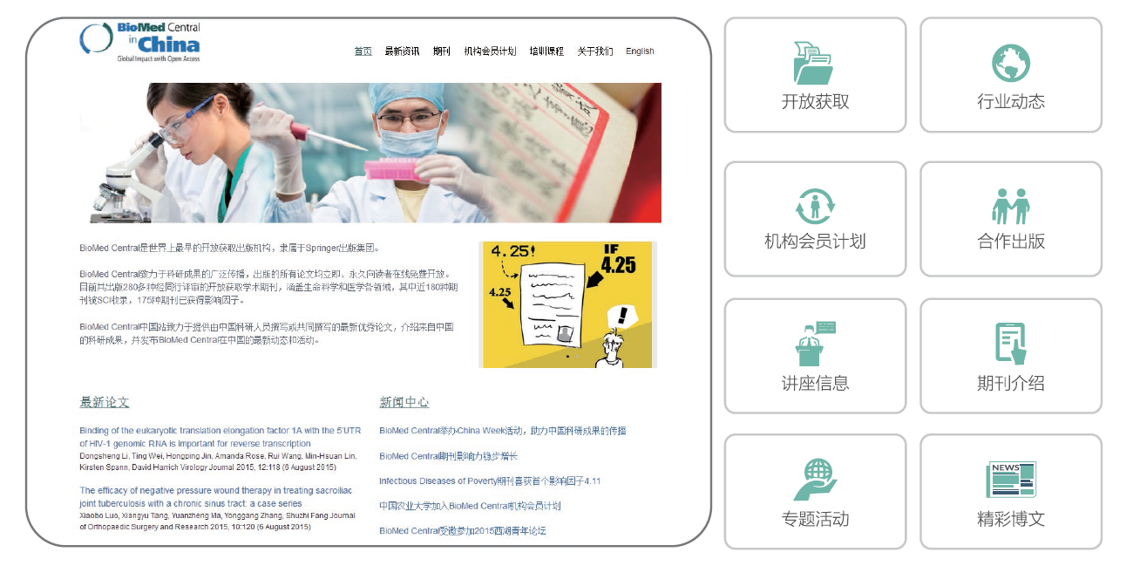
China Gateway 中国站
Notes:
节省审稿时间，提高审稿速度
白皮书
BMC Series 介绍
抄袭软件
记录feed back

